Slide 1



KOHA: EMBEDDED KNOWLEDGE SHARING USM - UPM
Date: 3rd - 4th of MAY 2017
Time: 9.00 am - 4.30 pm
Venue: Library Sultan Abdul Samad, UPM
By: Encik Mohd Nasir Md Rashid
SENIOR DEPUTY CHIEF LIBRARIAN

Slide 2
CONTENTS
1- Library New Paradigm for Open Solution System
2- Introduction to Koha Integrated Library Management System
3- Why Koha ?
4- Koha Users
5- Library System : Open Source Vs Proprietary
6- Koha System Architecture
7- Koha Modules
8- Koha and RFID
9- USM Library : The Beginning of Koha Open Source Integrated
Library Management System
10- Knowledge Sharing
11- Koha Team
12- Koha Expert Domain
13- Koha Pitfalls and Issues –Implementation Stage
14- Koha Best Practice and Method to Resolve
15- Steps Taken
16- Conclusion

Slide 3
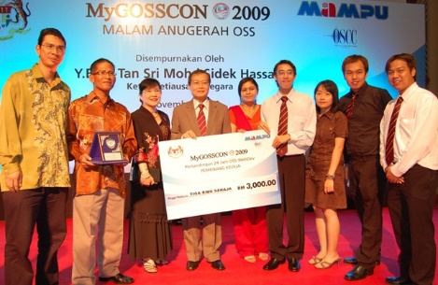
1- Library New Paradigm for Open Solution System
WHAT AND HOW LIBRARIANS’ SEES?
MAMPU INITIAVES
MYGOSCON Award
2009
National Open Source Software Case Study Awards
Reduce total cost of ownership
Increase growth of OSS user and developer community
Increase growth of OSS industry
Save cost = 10 000 books
Transforming Research and Innovation
Transforming Services and External Activities
Apex Agenda
Transforming Concentration of Talent
“Transforming Higher Education for a Sustainable Tomorrow”
Mampu: Goodbye eGovt, it’s all about Digital Government
→Phase I: 2008 - 2013
→Phase II: 2014 - 2025
→Launched: 16 July 2004
→Usage: Public Sector

Slide 4
2- Introduction to Koha Integrated Library Management System
KOHA
MORI WORD
GIFT / DONATION
HOROWHENUA LIBRARY
KATIPO COMMUNICATION
ALIVE JANUARY 2000
2008 Koha 2.2.9 installed at IPPT, USM
The World’s First Free and Open Source Library System

Slide 5
3- Why Koha ?
Open Standard
ISO 2709, Z39.50, SIP/NCIP
Stable
Excellent
Support
No Vendor
MARC Compliant
MARC21, USMARC, RDA
Fully Web Based
Cost Effective
Knowledge Transfer
Current Technologies

Slide 6
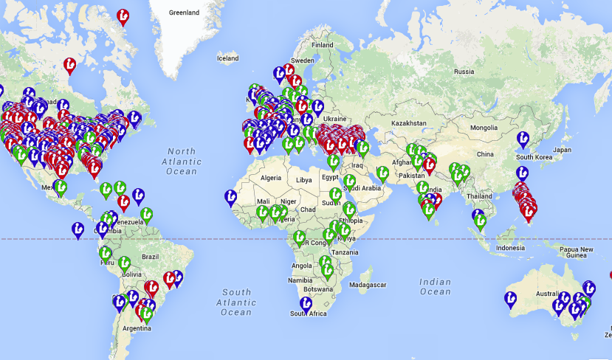
4- Koha Users
+6000 KOHA USERS

Slide 7
5- Library System : Open Source Vs Proprietary
CRITERION | OPEN SOURCE | PROPRIETARY
Cost Value | FREE with source code | Purchased WITHOUT source code
Vendor-log in | NO | YES
Maintenance | In-House | Vendor with Agreement Contract
License | NO | YES
SIP2 | YES | YES
Z39.5 | YES | YES
Application based | Web | Client
Support Service | Community | Vendor

Slide 8

6- Koha System Architecture
KOHA ILS
MYSQL
DATABASE
APACHE
LANGUAGE
WEB APP.
PEARL
PERL

Slide 9

7- Koha Modules
OPAC
Circulation
Cataloguing
Acquisition
Serials
Patron
Administration
Reports

Slide 10
ACQUISITION
7- Koha Modules
Enter budgets and funds
Duplicate budgets and funds for the following year
Keep track of all vendor information
Order from vendor files
Order multiple copies
Order copies of existing records
Order by searching Z39.50 targets
Track order status
Generate late reports and claim letters
Track budget encumbrances and expenditures
Create ‘on order’ items to allow patrons to place holds
Accept purchase suggestions and keep patrons notified as the item moves through the Acquisitions process

Slide 11
OPAC/USER INTERFACE
7- Koha Modules
Fully responsive theme will adjust properly on all devices
Keyword and advanced searching
Search filtering by location, item type, subjects and more
Cover images from over 5 popular services
Enhanced OPAC content from external products such as Open Library, Syndetics, Baker & Taylor, LibraryThing, Novelist Select and iDreamBooks
Tagging, commenting and star ratings
Availability and online resource links shown on search results
Virtual shelf browser
Social network share buttons
Personalized patron experience:
  Ability to place, suspend and cancel holds
  List of current and past checkouts
  Account history (fines and payments)
  Private lists
  Ability to register for a library card online
  Access to account information
  Make purchase suggestions

Slide 12
CIRCULATION
7- Koha Modules
Check in and out with a barcode scanner or manually
Enter calendar of closings for calculating fines and due dates
Book drop mode to backdate check ins
Ability to forgive fines on check in
Holds pull list generated on your schedule
Course reserves
Offline circulation for Windows and/or Firefox
Place, suspend and cancel holds for patrons
Transfer materials between branches
Set circulation, fine and holds rules for each branch
Perform collection inventory
Web-based self check out module
Checkout by keyword, title, call number, etc

Slide 13
PATRON
7- Koha Modules
Upload patrons in bulk
Upload patron images individually or in bulk
Create patron cards
Batch modify patrons
Run reports on circulation custom to your library
Search patrons by phone, email address, name and more
Browse patrons by name
Connect children to guardians and see an entire family’s current checkouts on one screen
Set rules to prevent check out of inappropriate materials to children
Add custom searchable fields to patron records

Slide 14
CATALOGING
7- Koha Modules
Add bibliographic and authority records by batch uploading
Add bibliographic and authority records by copy cataloging with a built in Z39.50 search engine
Add bibliographic and authority records using original cataloging
Add and modify items individually or in a batch
Add and link to authority records
Duplicate bibliographic records
Catalog following AACR2 or RDA rules
Create custom cataloging templates with pre-set values for efficient cataloging
Built in links to Library of Congress cataloging help
Create spine and barcode labels
Batch modify and delete item records
Create public lists of records at the library

Slide 15
SERIALS
7- Koha Modules
Create subscriptions with full prediction patterns
Receive issues one at time or in bulk
Barcode serials on receipt if desired
Generate late issue reports and claim emails
See full serial history
Print routing lists for each subscription
Duplicate subscriptions for multiple branches
Library defined numbering frequencies and patterns

Slide 16
REPORTS
7- Koha Modules
Complete access to all data stored in Koha; write any report you want
Custom reports shared publicly on the Koha wiki
Easily run any saved report at any time
Group reports by branch, category or any custom criteria
Enter filters on reports to run them on for specific item types, branches, patron categories, time frames and so much more
Search reports for easy access

Slide 17
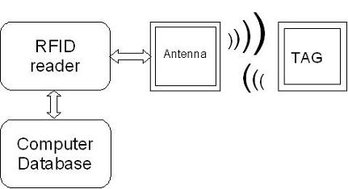
8- Koha and RFID
RFID SYSTEM
HF
UHF
125 KHz
13.56MHz
315 MHz
433 MHz
860-870 MHz
902-928 MHz
2.40-2.48 GHz
PASSIVE
PASSIVE
ACTIVE

Slide 18
9- USM Library: The Beginning of Koha Open Source Integrated Library Management System
THE JOURNEY BEGINS . . .
DOBIS-LIBIS
(1987-1997)
10 Years
PHOENIX
(1997-2004)
7 Years
ILMU
(2004-2014)
10 Years
KOHA
(2008-Until Now)

Slide 19

9- USM Library: The Beginning of Koha Open Source Integrated Library Management System
2008 – LIBRARY INSTITUT PERUBATAN DAN PERGIGIAN TERMAJU, USM
(KEPALA BATAS)
2009 – AWARD: KAJIAN KES TERBAIK ANJURAN
MAMPU JABATAN PERDANA MENTERI
2010 – AWARD: SANGGAR SANJUNG
2011 –14 LIBRARIES
PUSAT WILAYAH, PUSAT PENGAJIAN
JARAK JAUH
2012 – ENGINEERING LIBRARY, ENGINEERING CAMPUS
2013 – USM MAIN CAMPUS LIBRARY- TESTING PHASE
2014 – GO LIVE IN USM MAIN CAMPUS LIBRARY
PHASE I
AWARDS
PHASE II

Slide 20
10- Knowledge Sharing
EXEPRT CONSULTATION
  UNIVERSITI TENAGA NASIONAL (UNITEN)
  UNIVERSITI SAINS ISLAM MALAYSIA (USIM)
  UNIVERSITI PUTRA MALAYSIA (UPM)
  UNIVERSITI MALAYSIA SARAWAK (UNIMAS)
SITE VISIT
  KOLEJ KOMUNITI KEPALA BATAS
  UNIVERSITI MALAYA (UM)
  UNIVERSITI PUTRA MALAYSIA
  UNIVERSITI MALAYSIA SARAWAK (UNIMAS)
  UNIVERSITI TEKNIKAL MALAYSIA (UTeM)
  UNIVERSITI SAINS ISLAM MALAYSIA (USIM)
  UNIVERSITI TENAGA NASIONAL (UNITEN)
  UNIVERSITI UTARA MALAYSIA (UUM)
  MULTIMEDIA UNIVERSITI (MMU)
  QUEST INTERNATIONAL UNIVERSITY PERAK (QIUP)

Slide 21
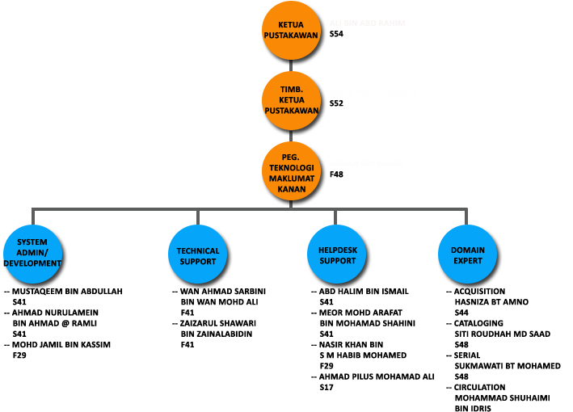
11- Koha Team

Slide 22
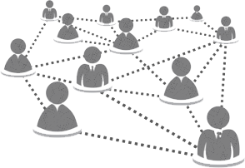
12- Koha Expert Domain
SUPPORT
EXPERTS
SELF EXPERTISE
COMMUNITY

Slide 23
13- Koha Pitfalls and Issues : Implementation Stage
Financial Issues- Budget Constraints
Gap of library system acceptance between librarians and system developers
The principal of open source awareness among librarians
The “fear” feeling among librarians to accept, use and adopt new technology
Open source devoted as “unstable technology” for library system
The librarians “mind set” that open source is for small library only
Neglect to change-The librarians attitude towards the norm of doing task
Worriedness on technical expertise and skills to use open source
Big Gap - Current Version vs New Released
Less Local Support
Handling Bad Perception
Dirty Data
    Duplicate
    Truncate
    Drop record
    Cataloging/Data Entry Error (Major? Minor?)
Koha Bugs

Slide 24
14- Koha Best Practice and Method to Resolve
PhD Research on Librarians Acceptance to Use Koha Open Source Library Information System Using the UTAUT Model by Zainab Ajab Mohideen (2017), an IT Officer from USM Library with 12 years of experience in library automation.
The research findings reflect the acceptance level of Koha among IPTA and IPTS Libraries are 0.798% (~80%) above the Excellent acceptance.
The librarians acceptance on Koha is based on System Quality , Information Quality, Performance Expectancy, Social Influence and Attitude towards using technology
The rejected acceptance on Koha is based on Information technology skill, cost, effort expectancy and self-efficacy. This indicates that information technology skill, cost, effort expectancy and self-efficacy are not relevant for Koha open source adoption in the library.
Follow Koha Release (Stable Release)
Get connected with Koha Community
Migration
    MARC21 Current Format Verification
    Know your current data, what it should be?
Implementation
    Koha Local Team (Implementation & Support)
    Centralization
    Support from management and staffs
    Check all Koha setting, preferences
    Review current library policy
Regular DB or System Backup (Image Backup)
Go For Koha!

Slide 25
15- Koha : Steps Taken
Data Clean up 2014 - Editing Data start on 27 Jan 2014 by Staffs of PHS, IPPT, and KJ.
Change domain from elib.eng.usm.my to elib.usm.my on 24/10/2013.
Koha 3.12.5 - (153 tables) - official release - upgrade and transfer to new server from koha.eng.usm.my to elib.eng.usm.my on 7/10/2013
Koha 3.12 - (152 tables) - Upgrade from 3.10 to 3.12 on 19/07/2013.
Koha 3.10 - (145 tables) - Cloned on 6/06/2013 for training purpose kohadev.eng.usm.my.
Koha 3.16.02 - Upgrade from 3.12 to 3.16.02 on 16/08/2014.
Koha 3.18.02 - Upgrade from 3.16 to 3.18.02 on 01/01/2015 / 10 Rabi'ul Awal 1436 Hijrah.
Koha 3.20.3 - Upgrade from 3.18.02 to 3.20.03 on 10/09/2015 / 26 Zulkaedah 1436 Hijrah.
Koha 3.22.01 - Upgrade from 3.20.03 to 3.22.01 on 31/12/2015 / 19Rabi'ul Awal 1437 Hijrah.

Slide 26
16- Conclusion
Koha Progress . . .
Koha 3.22.2
Koha 3.20.8
Koha 3.22.3
Koha 3.22.4
Koha 3.20.9
Koha 3.20.10
Koha 3.22.5
Koha 3.22.6
Koha 3.20.11
Koha 3.22.7
Koha 16.05
Koha 3.20.12
Koha 16.05.1
Koha 3.22.8
Koha 3.20.13
Koha 3.22.9
Koha 16.05.2
Koha 3.20.14
Koha 16.05.3
Koha 16.11.6 (year 2017)
More to come . . .

Slide 27

THANK YOU

